Slide 1
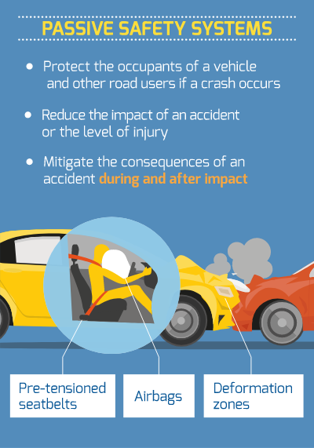
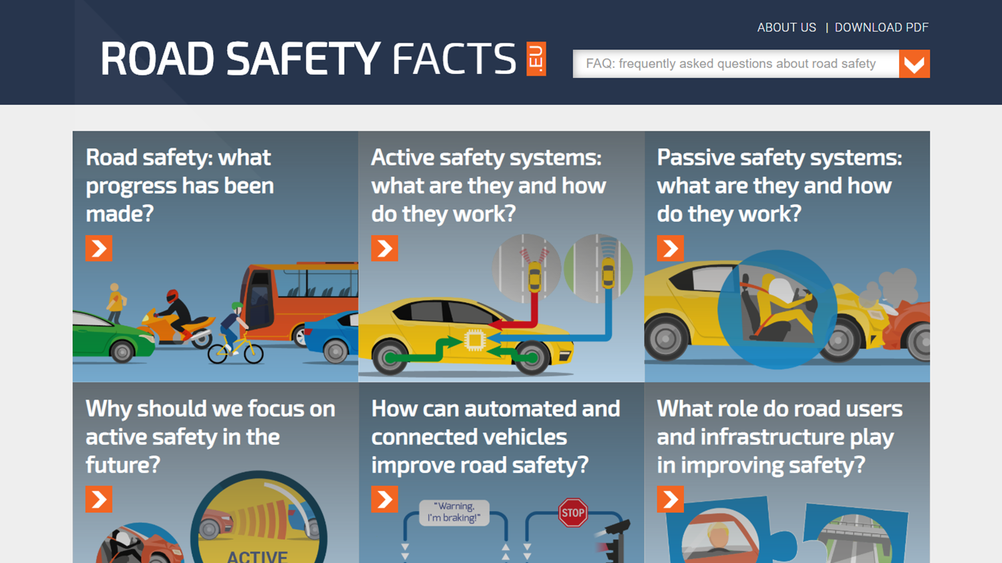


BETTER AND FASTER
EMERGENCY CARE DURING VECHILE IMPACT

Slide 2
Problem statement
Better and faster emergency care during accidents and vehicle impact

Slide 3

introduction
The main aim is to create a system software that reduces the amount of time wasted on accident sights that is the major cause that leads to deaths.
We aim to use as much fewer components to integrate our product into the car and the mobile phone to save the lives of people.

Slide 4
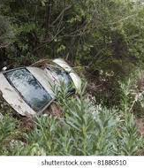

PREVIOUS SYSTEM
When an accident occurs the information is only sent through GSM, but it was very difficult to find the exact solution.
As a result of people eventually dies in just waiting for the help but initially ambulance is unable to track them.

Slide 5

Proposed system
The idea comprises of developing an application that will effectively connect all the stakeholders that are involved during an accident the driver, the hospital, and the ambulance.
The application will comprise of three operating modes namely the Driver, Ambulance and Hospital.

Slide 6
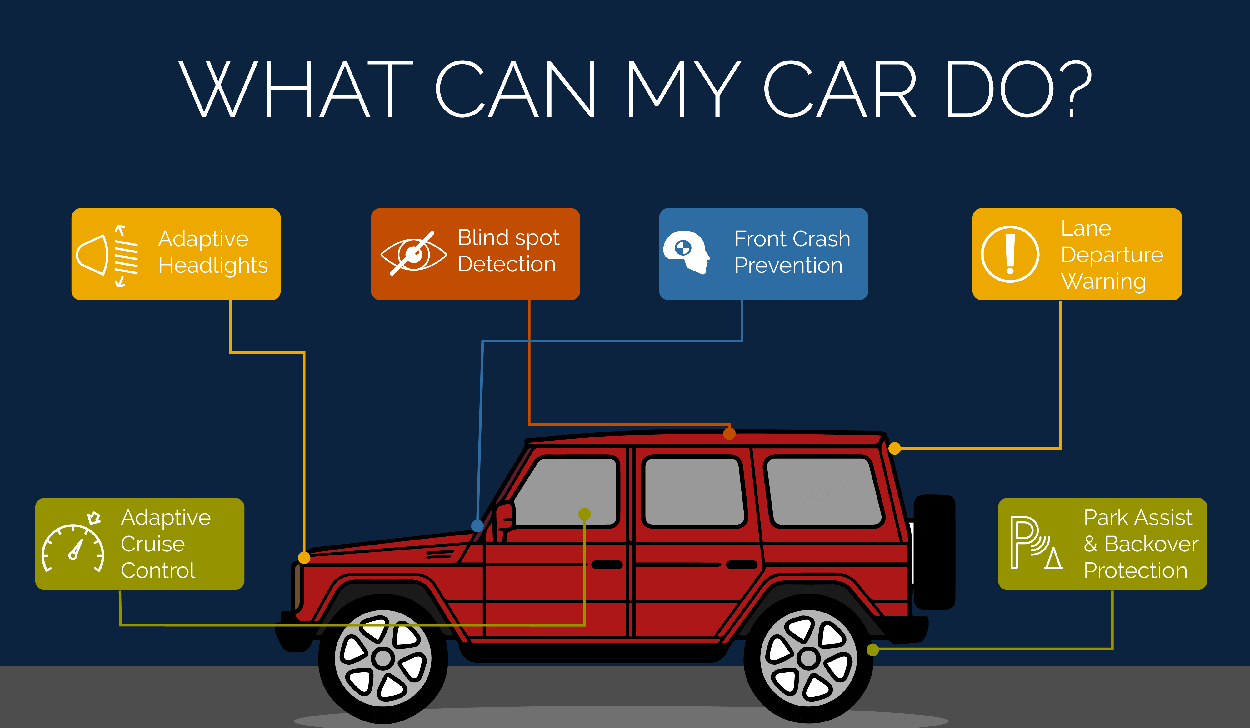


Slide 7
As soon as the accident occurs, the ABS preinstalled into the car will trigger a signal to the hardware module which is pre-installed in the car.
When the hardware module detects this signal, it fetches its location using the GPS module and sends these fetched coordinates to the server system.
Then the server will process this information sent from the accident site and then find and allocate the nearby hospital.

Slide 8
After selecting the hospital, it then selects the available number of the ambulance, number of beds available, and the main doctor is available or not of the hospital and then sends this ambulance to the accident site using the shortest path which would be provided by the system itself.
The allotted ambulance will reach the accident site with the exact coordinates sent by the hardware and then admits the patient in the ambulance.
After admitting the patient in the ambulance, the attendant present will take the complete information of the condition of the patient and upload it to the database.

Slide 9
Once the information of the patient is uploaded the hospital will make the necessary arrangements to attend to the patient.
01
Further, we will classify things based on pre-crash and post-crash measures so that the chances of any mishappening become very low.
02
If the person meets with a small accident or if there is no serious threat to anyone`s life, then the alert message can be terminated by the driver by a switch provided to avoid wasting the valuable time of the medical rescue team.
03

Slide 10
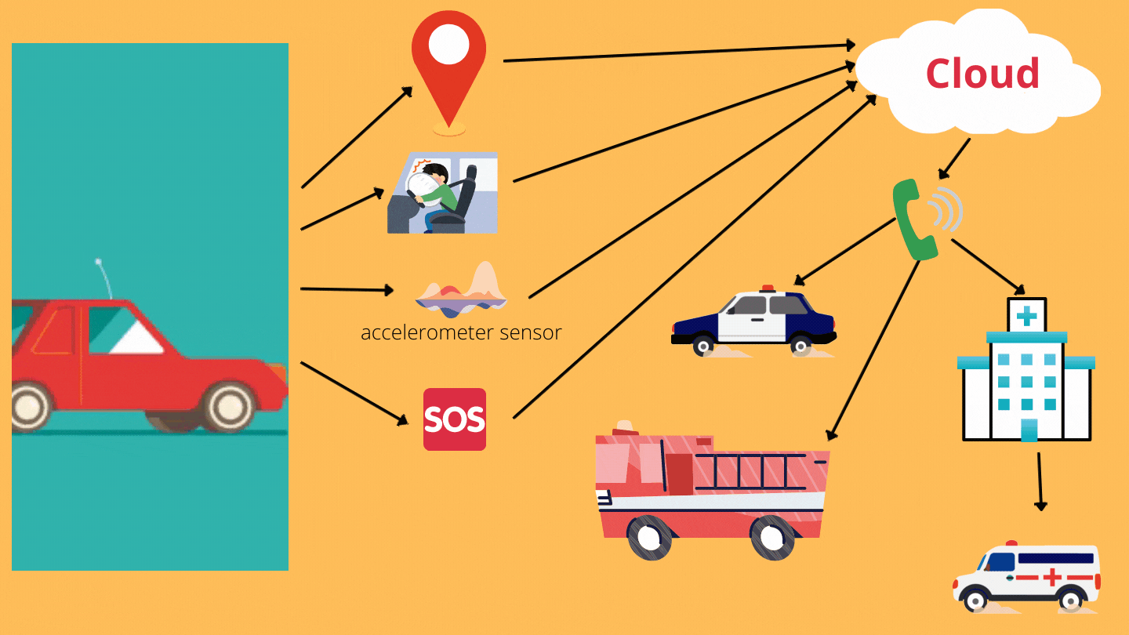

Slide 11


Technologies used

Slide 12


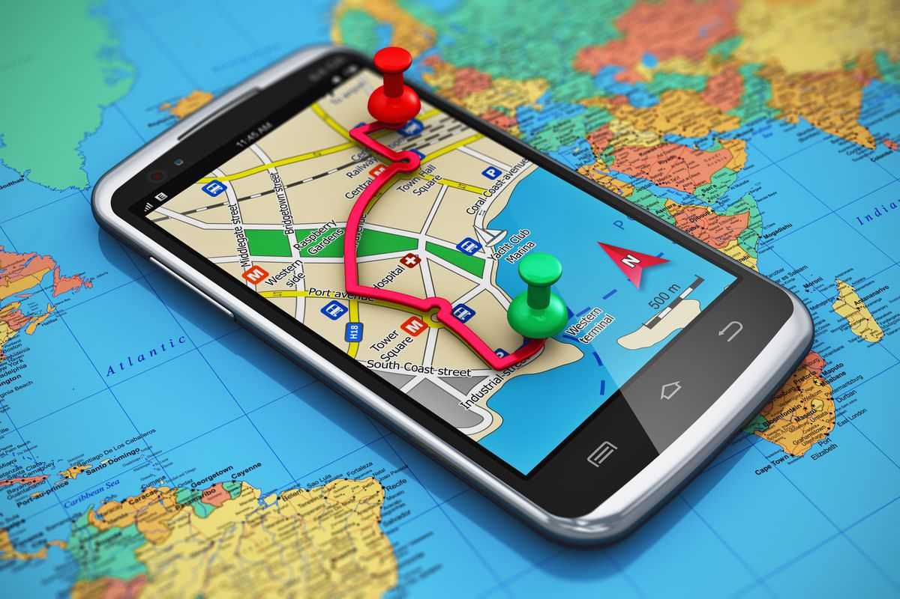

Machine Learning
Google Maps API
GSM module
GPS Device.
CCTV
SENSORS
AWS or Cloud computing
IOT

Slide 13
ADVANTAGES
cost effective
assured safety
victim life can be save quickly
low power consumption
better accuracy
efficient time consumption
reduce the chance of human error.

Slide 14

Business model
We will give our customers free one year accidental policy after that customer have to pay regular policy bill.
We will tie up from other policy companies also so that we can act as a broker and get commission in return
We will charge money on sim for outgoing and incoming internet services.
We can also use the persons data and hospital data (not the confidential one only the basic data) to advertise our services.

Slide 15

The life of a person would get saved in just a few minutes. As of I don’t think that anything would be much important than that.

Slide 16

Thank you
SAUMYA ARORA
ANKUSH PATEL
VAIBHAV CHOUHAN

